Slide 1
Chapter 19
Data Structures

Slide 2
Data Structures
A data structure is a particular organization
of data in memory.
  We want to group related items together.
  We want to organize these data bundles in a way that is
  convenient to program and efficient to execute.
Key Mechanisms:
  Array: a mechanism to group multiple elements of a homogeneous type
  Structure: a mechanism to group multiple elements of a heterogeneous type
  Both can be applied recursively…
19-<number>

Slide 3
Structures in C
A struct is a mechanism for grouping together
related data items of different types.
  Recall that an array groups items of the same type.
Example:
We want to represent an airborne aircraft:
char flightNum[7];
int altitude;
int longitude;
int latitude;
int heading;
double airSpeed;
We can use a struct to group these data together for each plane.
19-<number>

Slide 4
Defining a Struct
We first need to define a new type for the compiler
and tell it what our struct looks like.
struct flightType {
char flightNum[7]; /* max 6 characters */
int altitude; /* in meters */
int longitude; /* in tenths of degrees */
int latitude; /* in tenths of degrees */
int heading; /* in tenths of degrees */
double airSpeed; /* in km/hr */
};
This tells the compiler how big our struct is and
how the different data items (“members”) are laid out in memory.
But it does not allocate any memory.
19-<number>

Slide 5
Declaring and Using a Struct
Memory is allocated when
we declare a variable using our new data type.
struct flightType plane;
Then, we can access
individual members of this
variable:
plane.airSpeed = 800.0;
plane.altitude = 10000;
A struct’s members are laid out
in the order specified by the definition.
plane.flightNum[0]
plane.flightNum[6]
plane.altitude
plane.longitude
plane.latitude
plane.heading
plane.airspeed
19-<number>

Slide 6
Defining and Declaring at Once
You can both define and declare a struct at the same time.
struct flightType {
char flightNum[7]; /* max 6 characters */
int altitude; /* in meters */
int longitude; /* in tenths of degrees */
int latitude; /* in tenths of degrees */
int heading; /* in tenths of degrees */
double airSpeed; /* in km/hr */
} maverick;
And you can use the flightType name
to declare other structs.
struct flightType iceMan;
19-<number>

Slide 7
typedef
C provides a way to define a data type
by giving a new name to a predefined type.
Syntax:
typedef <type> <name>;
Examples:
typedef int Color;
typedef struct flightType WeatherData;
typedef struct ab_type {
int a;
double b;
} ABGroup;
19-<number>

Slide 8
Using typedef
This gives us a way to make code more readable
by giving application-specific names to types.
Color pixels[500];
Flight plane1, plane2;
Typical practice:
Put typedef’s into a header file, and use type names in
main program. If the definition of Color/Flight
changes, you don’t have to change the code in your
main program file.
19-<number>

Slide 9
Generating Code for Structs
Suppose our program starts out like this:
int x;
Flight plane;
int y;
plane.altitude = 0;
...
LC-3 code for this assignment:
AND R1, R1, #0
ADD R0, R5, #-13 ; R0=plane
STR R1, R0, #7 ; 8th word
y
plane.flightNum[0]
plane.flightNum[6]
plane.altitude
plane.longitude
plane.latitude
plane.heading
plane.airspeed
x
R5
19-<number>

Slide 10
Array of Structs
Can declare an array of structs:
Flight planes[100];
Each array element is a struct (7 words, in this case).
To access member of a particular element:
planes[34].altitude = 10000;
Because the [] and . operators are at the same precedence,
and both associate left-to-right, this is the same as:
(planes[34]).altitude = 10000;
19-<number>

Slide 11
Pointer to Struct
We can declare and create a pointer to a struct:
Flight *planePtr;
planePtr = &planes[34];
To access a member of the struct addressed by dayPtr:
(*planePtr).altitude = 10000;
Because the . operator has higher precedence than *,
this is NOT the same as:
*planePtr.altitude = 10000;
C provides special syntax for accessing a struct member
through a pointer:
planePtr->altitude = 10000;
19-<number>

Slide 12
Passing Structs as Arguments
Unlike an array, a struct is always passed by value
into a function.
  This means the struct members are copied to
  the function’s activation record, and changes inside the function
  are not reflected in the calling routine’s copy.
Thus, most of the time, you’ll want to pass a pointer to a struct.
int Collide(Flight *planeA, Flight *planeB)
{
if (planeA->altitude == planeB->altitude) {
...
}
else
return 0;
}
19-<number>

Slide 13
Dynamic Allocation
Suppose we want our weather program to handle
a variable number of planes – as many as the user wants
to enter.
  We can’t allocate an array, because we don’t know the
  maximum number of planes that might be required.
  Even if we do know the maximum number,
  it might be wasteful to allocate that much memory
  because most of the time only a few planes’ worth of data is needed.
Solution:
Allocate storage for data dynamically, as needed.
19-<number>

Slide 14
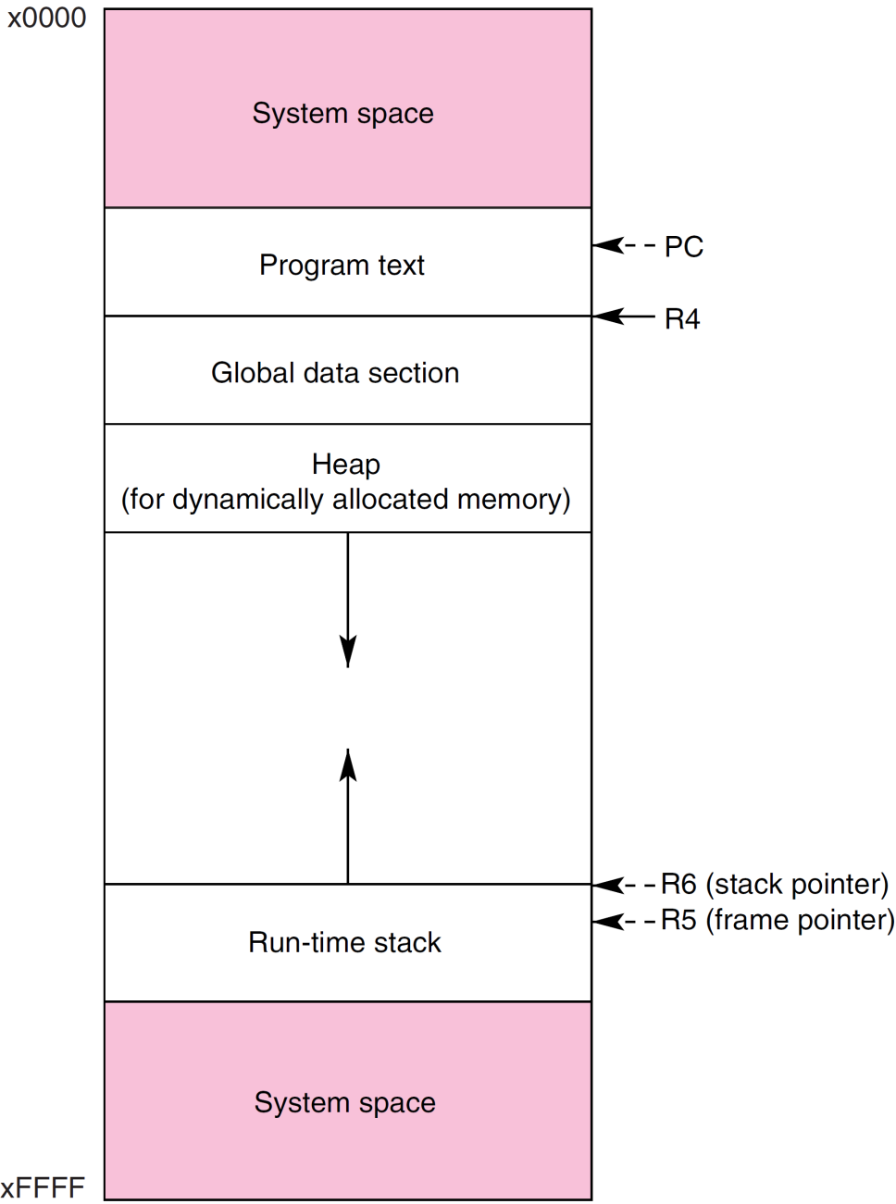
LC-3 Memory Map
19-<number>

Slide 15
malloc
The Standard C Library provides a function for
allocating memory at run-time: malloc.
void *malloc(int numBytes);
It returns a generic pointer (void*) to a contiguous
region of memory of the requested size (in bytes).
The bytes are allocated from a region in memory
called the heap.
  The run-time system keeps track of chunks of memory from the heap that have been allocated.
19-<number>

Slide 16
Using malloc
To use malloc, we need to know how many bytes
to allocate. The sizeof operator asks the compiler to
calculate the size of a particular type.
planes = malloc(n * sizeof(Flight));
We also need to change the type of the return value
to the proper kind of pointer – this is called “casting.”
planes =
(Flight*) malloc(n* sizeof(Flight));
19-<number>

Slide 17
Example
int airbornePlanes;
Flight *planes;
printf(“How many planes are in the air?”);
scanf(“%d”, &airbornePlanes);
planes =
(Flight*) malloc(sizeof(Flight) * airbornePlanes);
if (planes == NULL) {
printf(“Error in allocating the data array.\n”);
...
}
planes[0].altitude = ...
If allocation fails,
malloc returns NULL.
Note: Can use array notation
or pointer notation.
19-<number>

Slide 18
free
Once the data is no longer needed,
it should be released back into the heap for later use.
This is done using the free function,
passing it the same address that was returned by malloc.
void free(void*);
If allocated data is not freed, the program might run out of
heap memory and be unable to continue.
19-<number>

Slide 19
The Linked List Data Structure
A linked list is an ordered collection of nodes,
each of which contains some data,
connected using pointers.
  Each node points to the next node in the list.
  The first node in the list is called the head.
  The last node in the list is called the tail.
Node 0
Node 1
Node 2
NULL
19-<number>

Slide 20
Linked List vs. Array
A linked list can only be accessed sequentially.
To find the 5th element, for instance,
you must start from the head and follow the links
through four other nodes.
Advantages of linked list:
  Dynamic size
  Easy to add additional nodes as needed
  Easy to add or remove nodes from the middle of the list
  (just add or redirect links)
Advantage of array:
  Can easily and quickly access arbitrary elements
19-<number>

Slide 21
Example: Car Lot
Create an inventory database for a used car lot.
Support the following actions:
  Search the database for a particular vehicle.
  Add a new car to the database.
  Delete a car from the database.
The database must remain sorted by vehicle ID.
Since we don’t know how many cars might be on the lot
at one time, we choose a linked list representation.
19-<number>

Slide 22
Car data structure
Each car has the following characterics:
vehicle ID, make, model, year, mileage, cost.
Because it’s a linked list, we also need a pointer to
the next node in the list:
struct carType {
int vehicleID;
char make[20];
char model[20];
int year;
int mileage;
double cost;
Car *next; /* ptr to next car in list */
}
typedef struct carType Car;
19-<number>

Slide 23
Scanning the List
Searching, adding, and deleting all require us to
find a particular node in the list. We scan the list until
we find a node whose ID is >= the one we’re looking for.
Car *ScanList(Car *head, int searchID)
{
Car *previous, *current;
previous = head;
current = head->next;
/* Traverse until ID >= searchID */
while ((current!=NULL)
&& (current->vehicleID < searchID)) {
previous = current;
current = current->next;
}
return previous;
}
19-<number>

Slide 24
Adding a Node
Create a new node with the proper info.
Find the node (if any) with a greater vehicleID.
“Splice” the new node into the list:
new node
Node 0
Node 1
Node 2
NULL
19-<number>

Slide 25
Excerpts from Code to Add a Node
newNode = (Car*) malloc(sizeof(Car));
/* initialize node with new car info */
...
prevNode = ScanList(head, newNode->vehicleID);
nextNode = prevNode->next;
if ((nextNode == NULL)
|| (nextNode->vehicleID != newNode->vehicleID))
prevNode->next = newNode;
newNode->next = nextNode;
}
else {
printf(“Car already exists in database.”);
free(newNode);
}
19-<number>

Slide 26
Deleting a Node
Find the node that points to the desired node.
Redirect that node’s pointer to the next node (or NULL).
Free the deleted node’s memory.
Node 0
Node 1
Node 2
NULL
19-<number>

Slide 27
Excerpts from Code to Delete a Node
printf(“Enter vehicle ID of car to delete:\n”);
scanf(“%d”, vehicleID);
prevNode = ScanList(head, vehicleID);
delNode = prevNode->next;
if ((delNode != NULL)
&& (delNode->vehicleID == vehicleID))
prevNode->next = delNode->next;
free(delNode);
}
else {
printf(“Vehicle not found in database.\n”);
}
19-<number>

Slide 28
Building on Linked Lists
The linked list is a fundamental data structure.
  Dynamic
  Easy to add and delete nodes
The concepts described here will be helpful
when learning about more elaborate data structures:
  Trees
  Graphs
  Hash Tables
  ...
19-<number>

Slide 29
꼭 기억해야 할 것
Array: a mechanism to group multiple elements of a homogeneous type
Structure: a mechanism to group multiple elements of a heterogeneous type
Both can be applied recursively…
typedef: a mechanism to define a new data type from existing ones
malloc, free: library routines for dynamically allocating/deallocating memory from the heap
pointer-based data structure
  linked list
  tree, graph, hash table, etc
19-<number>

